Slide 1
Model-based Testing
CSE 4495 - Lecture 8 - 30/08/2022
Instructor : Md. Mohaiminul Islam

Slide 2
Models and Software Analysis
Before and while building products, engineers analyze models to address design questions.
Software is no different.
Software models capture different ways that the software behaves during execution.

Slide 3
Behavior Modeling
Abstraction - simplify problem by identifying and focusing only on important aspects.
Solve a simpler problem, then apply to the big problem.
A model is a simplified representation of an artifact.
Ignores all irrelevant elements of that artifact.

Slide 4
Software Models
Model is an abstraction of system being developed.
By abstracting unnecessary details, powerful analyses can be performed.
Can be extracted from specifications and design (or from code)
Illustrates intended behavior of the system.
Often state machines.
Events cause the system to react, changing its internal state.

Slide 5
Model-Driven Development
Models often created during requirements analysis.
Allows refinement of requirements.
Prove that properties hold over model.
Finite State Verification (next class) - used to analyze requirements, plan development, create test cases.
Can generate code from models.
Can create tests using model.

Slide 6
Finite State Machines

Slide 7
State Machines
Program execution as sequence of states transformed by actions.
“Behavior” is state -> action -> state transitions.
Set of all possible real behaviors is often infinite.
Called the “state space” of the program.
Models simplify a functionality or class state space into a finite set of states.

Slide 8
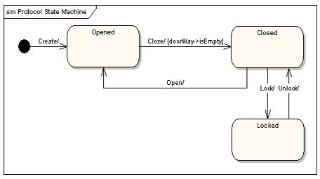
Finite State Machines
Nodes represent states
Abstract description of the current value of an entity’s attributes.
Edges represent transitions
Events cause state to change.
Labeled event [guard] / activity
event:The event that triggered the transition.
guard: Conditions that must be true to transition.
activity: Output behavior when this transition is taken.

Slide 9
Terminology
Event - An input that occurs at a defined time.
The user presses a self-test button.
The alarm goes off.
Condition - Internal or external property describing a change over time.
The fuel level has risen over a threshold.
The alarm has been on for ten seconds.

Slide 10
Terminology
State - Abstract description of the current value of the entity’s attributes.
(ex: Not “X=5; Y=10”, but “Normal Operating Mode”)
The controller is in the “self-test” state after the self-test button has been pressed, and leaves it when the reset button has been pressed.
The tank is in the “too-low” state when the fuel level is below the set threshold for N seconds.

Slide 11
States, Transitions, and Guards
States change in response to events (transition).
When multiple transitions are possible, the choice is guided by the current conditions.
Also called the guards on a transition.
We take the transition that satisfies all guards.

Slide 12
State Transitions
Transitions are labeled in the form:
event [guard] / activity
All three are optional.
Missing Activity: No output from this transition.
Missing Guard: Always take transition following event.
Missing Event: Take this transition immediately after entering preceding state (if guards met).

Slide 13
State Transition Examples
Transitions are labeled in the form:
event [guard] / activity
Controller enters “self-test” mode after test button is pressed, leaves when reset button is pressed.
User pressing self-test, reset buttons are events.
The tank enters “too-low” state when fuel level < threshold for N seconds.
Fuel level < threshold for N seconds is a guard.

Slide 14
Example: Simple Vending Machine
[item > 0]
Waiting for note
user ejects money
user inserts money
Balance Inserted
user Selects Product
[item -1 > 0]
/ dispense item
Out of stock
Item
Sold
[item -1 = 0] / dispense item

Slide 15
More on Transitions
Guards must be mutually exclusive
If event occurs and no
transition is valid, then event is ignored.
Able to Purchase
last bill ejected [balance = 0]
last bill ejected [balance > 0 && balance < needed]
last bill ejected [balance > 0 && balance >= needed]
Waiting for Money
More Money Needed

Slide 16
Internal Activities
Can react to events and conditions without transitioning using internal activities.
Typing
entry / highlight all
exit / update field
character entered / add to field
help requested [verbose] / open help page
help requested [minimal] / update status bar
Special events: entry
and exit.
Other activities occur each “time step”, until a transition occurs.
Entry and exit not
re-triggered.

Slide 17
Example: Maintenance Tracking
Customers send products for maintenance.
Maintenance tracking function notes current stage of maintenance process for each customer.
Transition path determined by a set of rules.
States = stages of process.
Transitions shows paths through process.
Model only what software tracks and controls!

Slide 18
Example: Maintenance Tracking
If the product is covered by warranty or maintenance contract, maintenance can be requested through the web site or by bringing the
item to a designated maintenance station.
No Maintenance
Waiting for Pick Up
If the maintenance is requested by web and the customer is a US
resident, the item is picked up from the customer. Otherwise, the
customer will ship the item.
Request - No Warranty
If the product is not covered by warranty or the warranty number is not valid, the item must be brought to a maintenance station. The station informs the customer of the estimated cost. Maintenance starts when the customer accepts the estimate. If the customer does not accept, the
item is returned.
Wait for Acceptance
Wait for Returning

Slide 19
Example: Maintenance Tracking
Repair at Station
If the maintenance station cannot solve the problem, the product is sent to the regional headquarters (if in the US) or the main headquarters (otherwise). If the regional headquarters cannot solve the problem, the product is sent
to main headquarters.
Repair at Regional HQ
Repair at Main HQ
Maintenance is suspended if some components are not
available.
Wait for Component
Once repaired, the product is returned to the customer.
Repaired

Slide 20
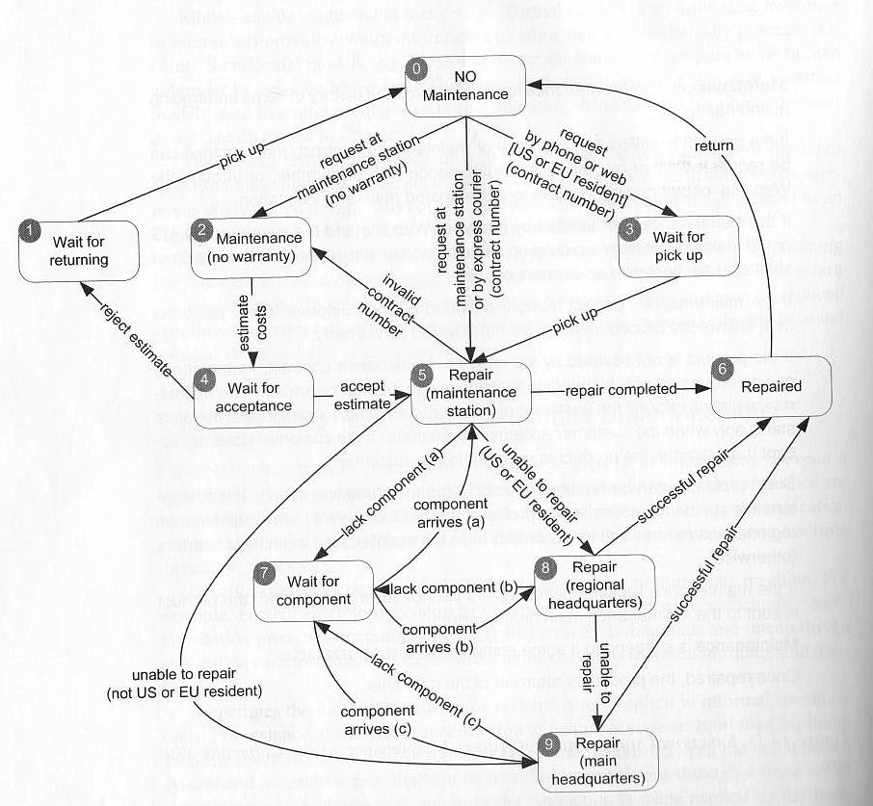
Example: Maintenance Tracking

Slide 21
Example - Computer Model
Model
ModelID Slots isLegal
selectModel(modelID) deselectModel addComponent(slot, component) removeComponent(slot) isLegalConfiguration()
Many classes have stateful behavior.
States = class variables
Transitions = method calls
Derive model from class and create tests.
Ex: We sell computers on our website. Model class represents a model of computer.
Slot
Model Component Required
incorporate(model) bind(component) unbind() isBound()

Slide 22
Slot Specification
Slot represents a configuration choice in all instances of a particular model of computer. A given model may have zero or more slots, each of which is marked as required or optional. If a slot is marked as required, it must be bound to a suitable component in all legal configurations. Slot offers the following methods:
Incorporate: Make a slot part of a model, and mark it as either required or optional. All instances of a model incorporate the same slots.
Bind: Associate a compatible component with a slot.
Unbind: The unbind operation breaks the binding of a component to a slot, reversing the effect of a previous bind operation.
IsBound: Returns true if a component is currently bound to a slot, or false if the slot is currently empty.

Slide 23
Slot State Machine
isBound()
No Component Bound
unbind()
Component Bound
No Model
isBound()
incorporate (model)
bind (component)
unbind()
Do not derive too many states.
Map variables to abstract values, not a state for each possible combination of values.
Model how a method affects a class.
States only need to capture interactions between methods and the class state.

Slide 24
Example - Model
Model represents the current configuration of a model of computer.
A given model may have zero or more slots, each of which is marked as required or optional.
Each slot may contain a single component.
To be a legal model, the model ID must exist in the ModelDB, each slot marked as required must be filled, the configuration must match that of the ModelDB entry for the model ID, and the optional components must match those allowed for that model in the ModelDB.

Slide 25
Example - Model
selectModel(modelID): Sets the model ID to the value passed in, as long as the model ID is set to “no model selected”. A model ID must be set before any other services are requested.
deselectModel(): Sets the model ID to “no model selected”. If the configuration was previously judged to be legal, it is no longer legal.
addComponent(slot, component): Adds the selected component to the selected slot. If the configuration was previously judged to be legal, it is no longer legal.
removeComponent(slot): Removes the selected component to the selected slot. If the configuration was previously judged to be legal, it is no longer legal.
isLegalConfiguration(): Compares the current configuration to the entry in ModelDB. If the configuration is valid, the Model’s isLegal field is set to “true”.

Slide 26
Choosing States
No Model
Legal Configuration
Configuring
Selected
What does the class represent?
e.g., a computer model.
What causes method results to differ?
e.g., whether the model is legal or illegal.
Can the class be in any other states?
e.g., we may not have set the model yet, we could still be making decisions and have not determined legality.

Slide 27
Choosing Transitions and Initial State
No Model
Selected
deselectModel()
selectModel(model)
deselectModel()
addComponent (slot,component)
Configuring
remove Component(slot)
isLegalConfiguration() [legalConfig=false]
isLegalConfiguration()
[legalConfig=true]
Legal
remove Component(slot)
addComponent (slot,component)
Configuration

Slide 28
Model Coverage Criteria

Slide 29
Test Creation
Tests created from models can be applied to the real program.
Events translated into method/API calls.
Program output (abstracted) should match model output.
Model coverage maps to requirements coverage.
Tests should be effective for verification.
Exercises stateful behavior thoroughly.
Coverage criteria based on states, transitions, paths.

Slide 30
State Coverage
Each state must be reached by test cases.
Unless model has been placed in each state, faults cannot be revealed.
Num. of Covered States / Number of States
Easy to understand and obtain, but low fault-revealing power.
Software takes action during transitions
Most states can be reached through multiple transitions.

Slide 31
Transition Coverage
A transition specifies a pre/post-condition.
“If system is in state S and sees event I, then after reacting to it, the system will be in state T.”
Faulty system could violate (pre, post-condition) pairs.
Every transition must be covered by test cases.
Num. Covered Transitions / Number of Transitions

Slide 32

Example: Maintenance
If no “final” states, we could achieve transition coverage with one large test case.
Smarter to target sections in different test cases.
Example Paths:
T1: request w/ no warranty (0->2) - estimate costs (2->4) - reject (4->1) - pick up (1->0)
T2: 0->5->2->4->5->6->0
T3: 0->3->5->9->6->0
T4: 0->3->5->7->5->8->7->8->9->7->9->6->0
T5: 0->5->8->6->0

Slide 33
Example - Slot
isBound()
unbind()
Component Bound
No Model
No Component Bound
isBound()
incorporate (model)
bind
(component)
unbind()
Tests are series of method calls.
incorporate(model), isBound(), unbind()
incorporate(model), bind(component), isBound()
incorporate(model), bind(component), unbind(), isBound()

Slide 34
Example - Model
No Model Selected
TC1:
selectModel(M1) [M1, 1 slots = C1] deselectModel()
deselectModel()
selectModel(model)
selectModel(M1)
addComponent(S1,C1) isLegalConfiguration() //true deselectModel()
deselectModel() remove Component(slot)
addComponent (slot,component)
Configuring
isLegalConfi guration() [legalConfig
=true]_{Valid}
isLegalConfi guration() [legalConfig
=false]
TC2:
selectModel(M1) [M1, 1 slot = C1] addComponent(S1,C1) isLegalConfiguration() //true addComponent(S2,C2) isLegalConfiguration() // false removeComponent(S2) isLegalConfiguration() // true removeComponent(S1)
addComponent (slot,component)
remove Component(slot)
Configuration

Slide 35
Path Coverage Criteria
Transition coverage based on assumption that transitions are independent.
Many machines exhibit “history sensitivity”.
Transitions available depend on path taken.
“wait for component” in Maintenance Tracking example.
Path-based metrics can cope with sensitivity.

Slide 36
Path Coverage Metrics
Single State Path Coverage
Requires that each subpath that traverses states at most once to be included in a path that is exercised.
Single Transition Path Coverage
Requires that each subpath that traverses a transition at most once to be included in a path that is exercised.
Boundary Interior Loop Coverage
Each distinct loop must be exercised minimum, an intermediate, and a large number of times.

Slide 37
Single State (Transition) Path Coverage
Single State (or Transition) Path Coverage
Each subpath
that traverses a state (or transition) at most once must be exercised.

Slide 38
Single State (Transition) Path Coverage
Single State (or Transition) Path Coverage
Each subpath
that traverses a state (or transition) at most once must be exercised.

Slide 39
Single State (Transition) Path Coverage
Single State (or Transition) Path Coverage
Each subpath
that traverses a state (or transition) at most once must be exercised.

Slide 40
Single State (Transition) Path Coverage
Single State (or Transition) Path Coverage
Each subpath
that traverses a state (or transition) at most once must be exercised.

Slide 41
We Have Learned
Models can be used to systematically create tests.
Exercises stateful behavior of a class or functionality.
Maps well to requirements.
State machines model expected behavior.
Cover states, transitions, non-looping paths, loops.
Can also verify properties over models as part of verification (next class).

Slide 42
Next Time
Finite State Verification
Optional Reading - Pezze and Young, Chapter 8
2018-08-27
Chalmers University of Technology

Slide 43
Thank You

